Slide 1

Micro- en nanotechnology
Thin film deposition techniques and lithography

Slide 2

MiNaT part 2
6 lectures
Weeks: 1, 3, 5, 7, 9, and 11
Literature: scientific papers (except introductory lecture)
Labo 4: solar cells and transparent conductive contacts
Schedule of group1 / group 2
Introduction November 17th, 9.30 @diepenbeek
Labo 5: November 23nd /28th, 14.00 / 9:00 @ Energyville
Labo 6: December 6th/7th 9.00 /14030 @ Energyville
Travel time accounted for: 30 minutes
Carpool sheet in toledo
One review paper (deadline 1st of December 23.59)
Reviewing deadline: 22nd of December 23.59
More info in toledo paper tab / lecturer 23th November and 7th December

Slide 3

Energyville 2
Thor Park ~ 20 minutes ride

Slide 4
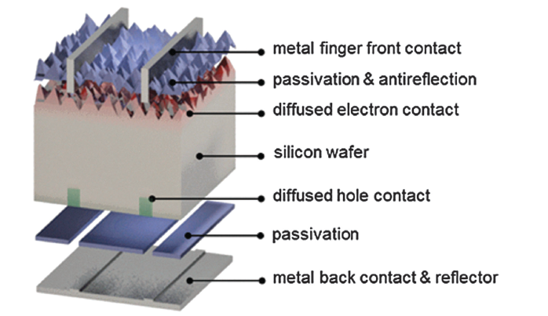
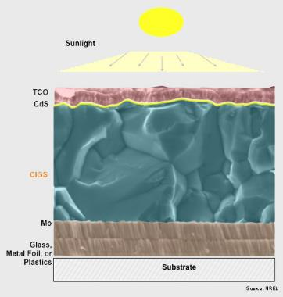
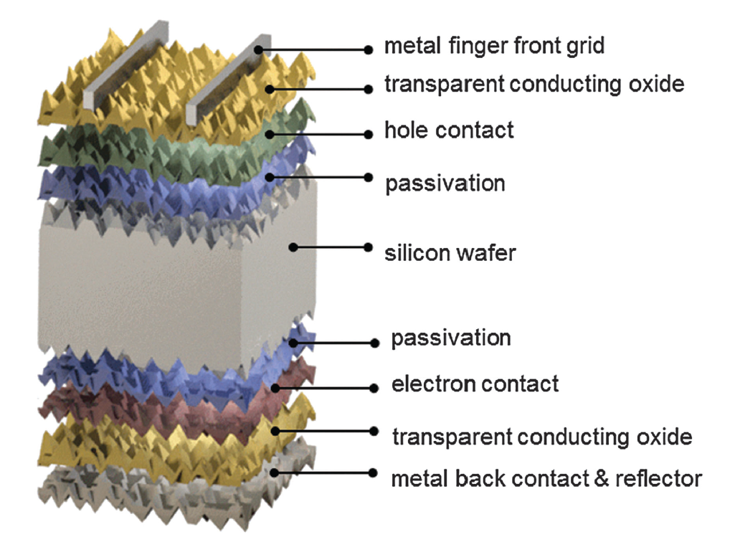
Thin film deposition techniques
Si PV: thin film layers for passivation, anti-reflection, contacts, ..
Thin film PV: all layers are thin film

Slide 5
Thin film deposition techniques
Wide variety of deposition techniques available
Wet chemical:
Screen printing; Chemical bath deposition
Atomic layer deposition (ALD)
Chemical vapour deposition (CVD)
PECVD
Physical vapour deposition (PVD)
Sputtering; evaporation
Choice of method depends on costs, feasibility, throughput, thickness, homogeneity, quality of the film, required electrical properties, ....

Slide 6
Thin film deposition techniques
Rear passivated Si solar cell
Screen printing
Plasma Enhanced
Chemical Vapour
Deposition (PECVD)
~ 10s nm
Atomic Layer Deposition (ALD) / lithography ~ 1-10 nm
Screen printing

Slide 7
Thin film deposition techniques
Hetero-junction Si solar cell
Screen printing
Sputtering ~ 100s nm
PECVD ~ 10s nm
PECVD 10s nm
Sputtering ~ 100s nm
Screen printing

Slide 8

Thin film deposition techniques
Thin film CIGS solar cell
Sputtering ~ 100s nm
Chemical bath deposition ~ 10s nm
Evaporation ~ 1-3 µm
Sputtering ~ 100s nm
https://www.solar-facts-and-advice.com/CIGS-solar-cell.html

Slide 9
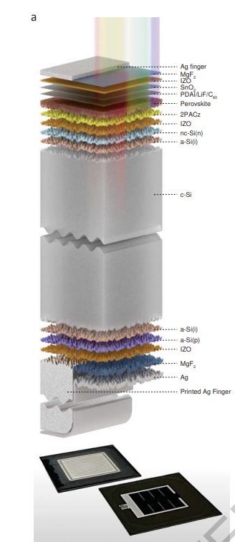
Thin film deposition techniques
Tandem solar cell

Slide 10
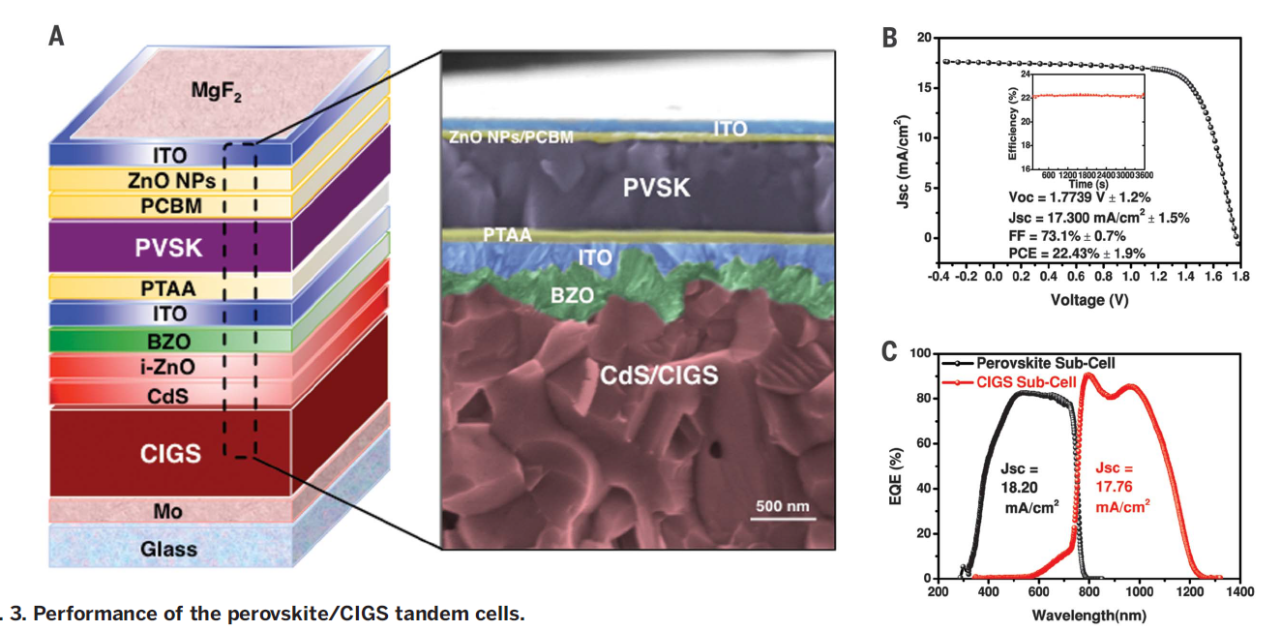
Thin film deposition techniques
Tandem solar cell

Slide 11
Thin film deposition techniques
Examples in solar cells:
Wet chemical:
CdS layers in CIGS
Perovskite active layer
Atomic layer deposition:
AlO_{X} passivation layer in Si solar cells
Chemical vapour deposition:
a-Si in Si heterojunction solar cells
SiN₂ SiO_{x} passivation layers in Si solar cells
Physical vapour deposition:
Sputtering – TCO layers in all solar cells

Slide 12
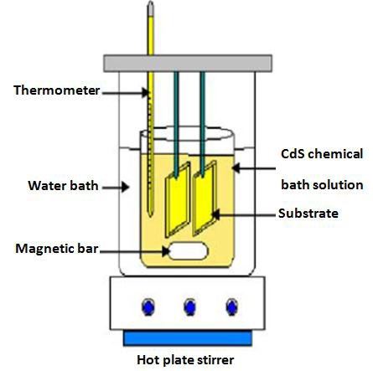
Thin film deposition techniques
Wet chemical: wet process step followed by drying step
Chemical bath deposition (CBD) of CdS layer
Substrate will be submerged in aqueous solution
Stirring and heating of solution
Precursors in the solution reacts on the surface of the substrate
Thin film will grow on the surface

Slide 13
Thin film deposition techniques
Wet chemical: wet process step followed by drying step
Chemical bath deposition (CBD) of CdS layer
Self limiting growth
Thickness ~ 10s of nm depending on concentration, temperature and time
Temperature 50-80 degrees (often water is used as liquid)
Cd⁺
Dry step: nitrogen flow, air flow, may include heating
CdS
S²⁻
CdS by CBD also cleans the CIGS surface and is preferential over CdS evaporation or sputtering

Slide 14
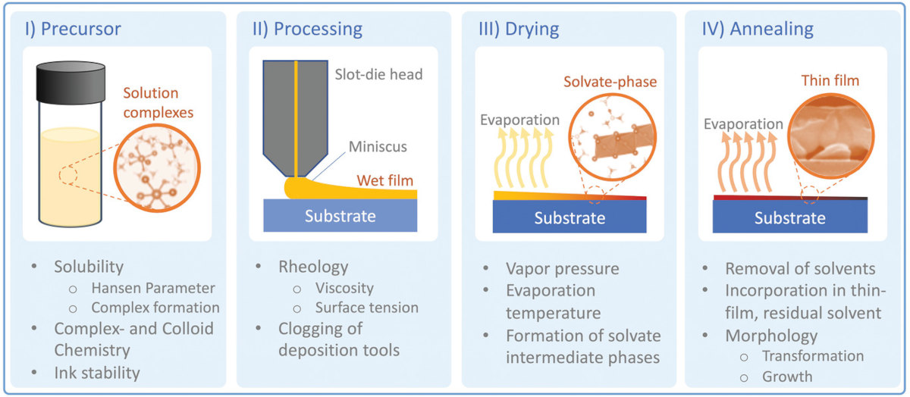
Thin film deposition techniques
Wet chemical: (slot-die) coating
Perovskite layer
Most efficient perovskite solar cells are prepared by coating and is preferential over evaporation or sputtering
https://www.perovskite-info.com/researchers-advance-slot-die-coated-perovskite-solar-cells-and-ink-properties

Slide 15
Thin film deposition techniques
Atomic layer deposition: ALD
Atomic layer deposition
Atomic Layer Deposition (ALD) / lithography ~ 1-10 nm

Slide 16
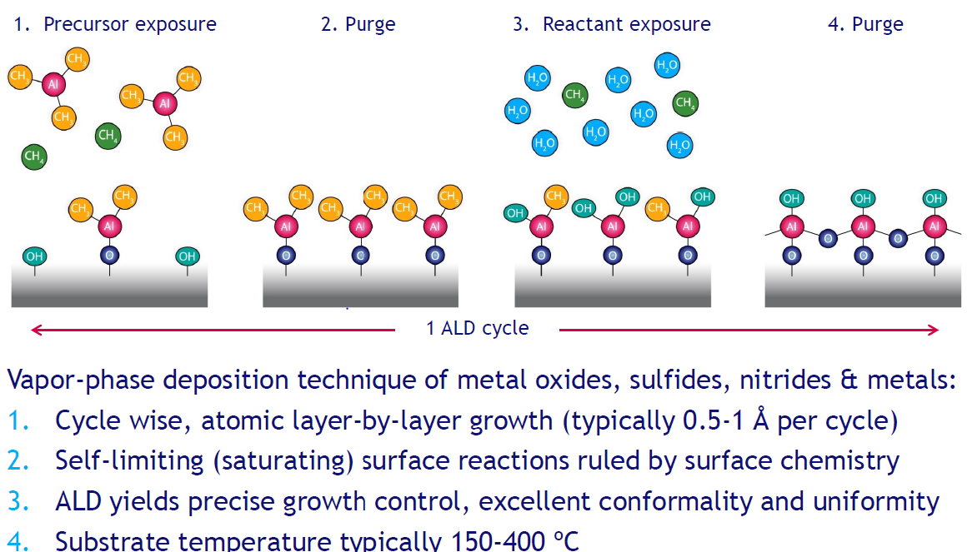
Thin film deposition techniques
Atomic layer deposition: ALD
Atomic layer deposition

Slide 17
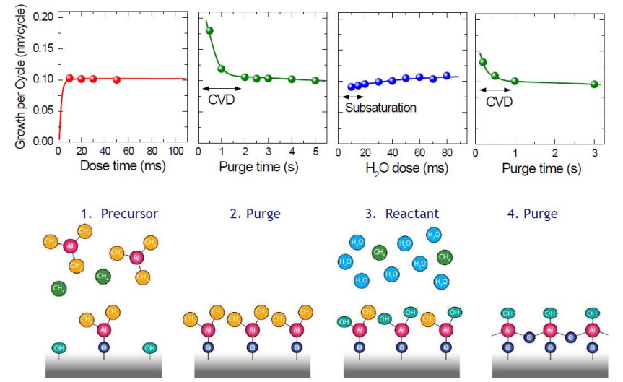
Thin film deposition techniques
Atomic layer deposition: ALD
ALD saturation curve

Slide 18
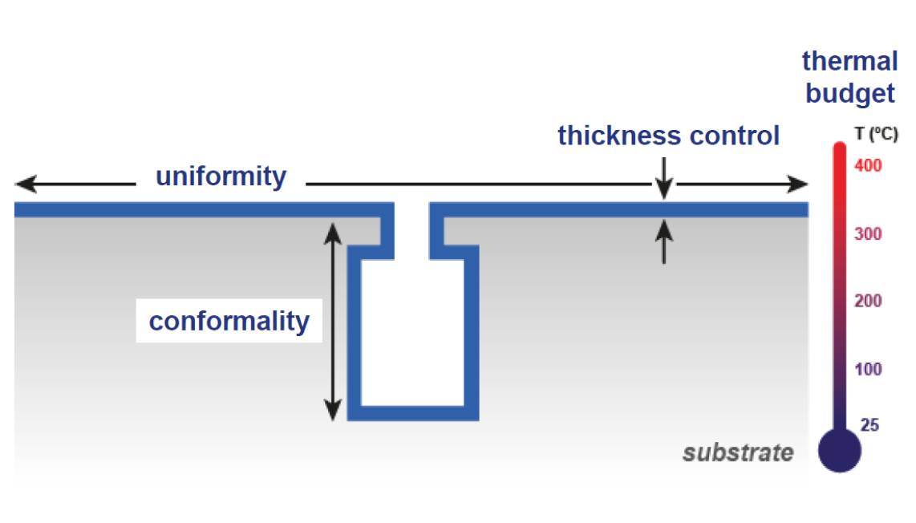
Thin film deposition techniques
ALD of AlOx
Conformal coating
Atomic thickness precision
Low temperature
Slow process
High purity precursors required
Atomic Layer Deposition - ScienceDirect

Slide 19
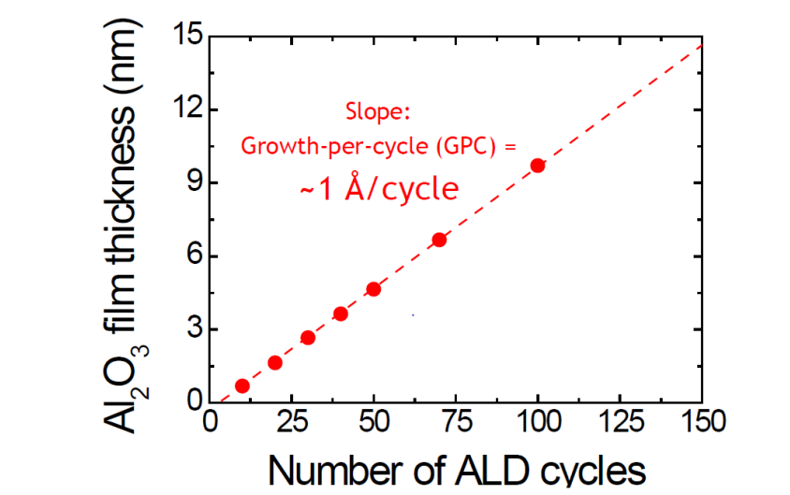
Thin film deposition techniques
Atomic layer deposition of AlOx
Conformal coating
Atomic thickness precision
Low temperature
Slow process
High purity precursors required
Atomic Layer Deposition - ScienceDirect

Slide 20
Thin film deposition techniques
CVD: exposure of the surface to precursors that react on the same surface. Usually, by products are produced
SiN, SiOx
Plasma Enhanced
Chemical Vapour
Deposition (PECVD)
~ 10s nm
Materials 2021, 14(19), 5658; https://doi.org/10.3390/ma14195658

Slide 21
Thin film deposition techniques
CVD: exposure of the surface to precursors that react on a surface. Usually, by products are produced
a-Si (p and n-type doped)
PECVD ~ 10s nm
PECVD 10s nm
Materials 2021, 14(19), 5658; https://doi.org/10.3390/ma14195658

Slide 22
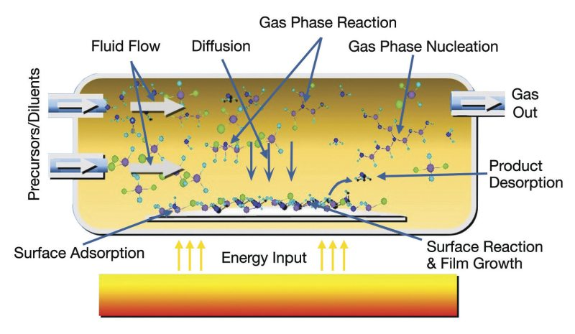
Thin film deposition techniques
CVD: exposure of the surface to precursors that react on a urface. Usually, by products are produced
Vacuum chamber with carrier gas (often Argon)
(diluted) precursors enter the chamber
Heated substate where the chemicals can react, and film will grow
By-products and carrier gasses are pumped away from the chamber
https://www.mks.com/n/thin-film-deposition-overview
Notes:
Ionized molecules - electrons

Slide 23
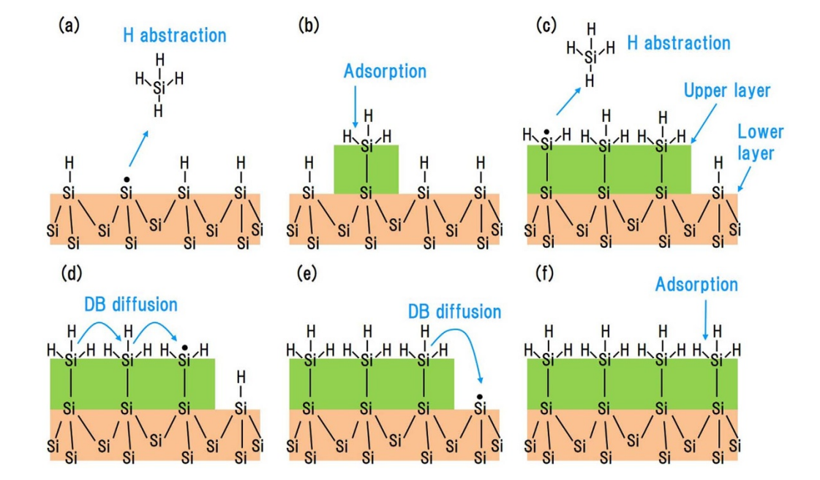
Thin film deposition techniques
CVD: exposure of the surface to precursors that react on a surface. Usually, by products are produced
a-Si growth (intrinsic, p and n-type)
Gasses in: SH₄ (silane), H₂ and diluted in Ar
For n-type a-Si: PH₃
For p-type a-Si: B₂H₆
Si dangling bonds react Silane molecules
Gasses pumped away: N₂ and Ar
Temperature between 150 – 300 °C
Film growth and quality depends on temperature,
concentration pre-cursers, flow in and out
SCIENTIFIC REPORTS | 5 : 9052 | DOI: 10.1038/srep09052
Notes:
Ionized molecules - electrons

Slide 24
Thin film deposition techniques
PVD: deposited materials goes from a condensed phase to a vapor phase and then back to a thin film condensed phase on the surface
Sputtering
Sputtering ~ 100s nm
Sputtering ~ 100s nm

Slide 25
Thin film deposition techniques
PVD: deposited materials goes from a condensed phase to a vapor phase and then back to a thin film condensed phase on the surface
Sputtering and evaporation
Sputtering ~ 100s nm
Evaporation ~ few µm
Sputtering ~ 100s nm

Slide 26
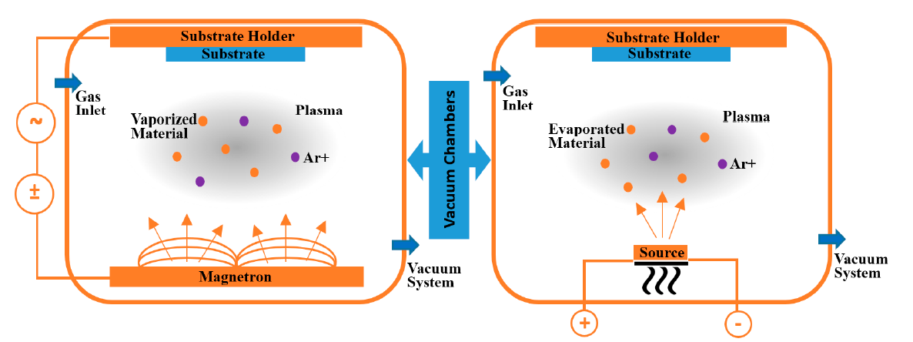
Thin film deposition techniques
PVD: deposited materials goes from a condensed phase to a vapor phase and then back to a thin film condensed phase on the surface
Evaporation
Materials to be deposited will be heated until evaporation temperature
Sources to heat: e-beam, laser beam, electricity, ...
Particles will be released
Microscopic particles will be deposited onto the substrate
Dependent on melting point of deposited materails
Coatings 2018, 8, 402

Slide 27
Thin film deposition techniques
PVD: deposited materials goes from a condensed phase to a vapor phase and then back to a thin film condensed phase on the surface
Co-Evaporation
Materials to be deposited will be heated until evaporation temperature
Sources to heat: e-beam, laser beam, electricity, ...
Multiple source are heated simultaneously
Ratios between evaporation rates of different elements required careful tuning
Cu(In,Ga)Se₂ → Cu:(In,Ga) 1:1, Se in overpressure
Coatings 2018, 8, 402

Slide 28
Thin film deposition techniques
PVD: deposited materials goes from a condensed phase to a vapor phase and then back to a thin film condensed phase on the surface
Sputtering or evaporation
Sputtering:
High power is applied between sputter-target and substrate holder
Neutral particles are ejected from the sputter-target due bombardment of high energy particles
Microscopic particles are released with high energy
Via collisions between the substrate and target energy is released
Microscopic particles will be deposited onto the substrate
Coatings 2018, 8, 402
Notes:
A negative voltage of typically − 300 V or more is applied to the target. This negative voltage attracts positive ions to the target ejecting particles from the target after collision

Slide 29
Thin film deposition techniques
PVD: deposited materials goes from a condensed phase to a vapor phase and then back to a thin film condensed phase on the surface
Sputtering
Magnetron sputtering:
Utilize strong electric and magnetic fields to confine charged plasma particles close to the surface of the sputter target
Higher density of ejected particles from the target
Coatings 2018, 8, 402
Notes:
Magentron sputtering:

Slide 30
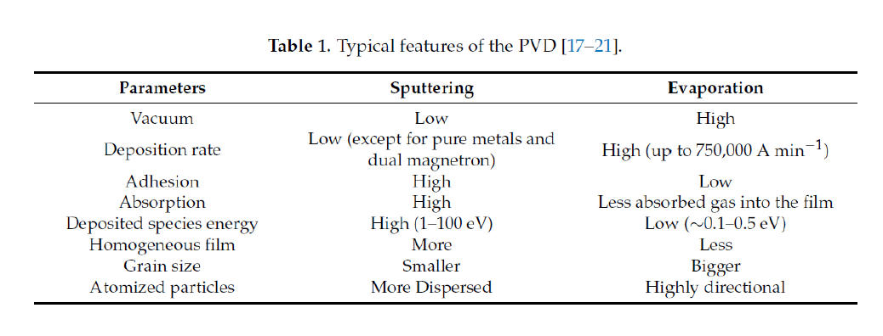
Thin film deposition techniques
Evaporation vs sputtering
Scientific REPORTs | 7:45463 | DOI: 10.1038/srep45463
Notes:
Distance from release of the particles to substrate, adhesion due to bombarbment,

Slide 31
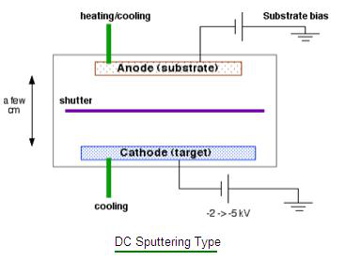
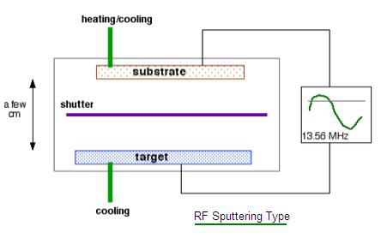
Thin film deposition techniques
Sputtering
Electric power source:
Direct (DC) vs alternating radio frequency current (RF)
RF is required to avoid built in charges as the target are not conductive
DC: Conducting target, metals
Fast sputtering rate
RF: Insulating materials, semi-conductors
Slow sputtering rate (~20% of DC)
More expensive and complex
https://www.aemdeposition.com/sputtering-targets-news/dc-sputtering-vs-rf-sputtering.html
Notes:
DC: metals, neatrial particles RF: Charge build-up on insulating targets can be avoided with the use of RF sputtering where the sign of the anode-cathode bias is varied at a high rate (commonly 13.56 MHz).

Slide 32
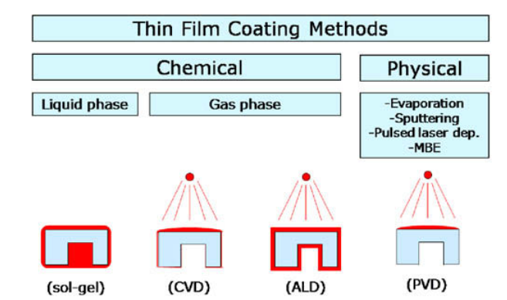
Thin film deposition techniques
Sputtering
DC: metals
RF: semiconductors: ITO, Al doped-ZnO, CIGS, CuO, ....
RF: insulators: AlOx, ZnO, NiO, ...
Thickness ~ 10s nm to few micrometers thick
Temperature ~ Room temperature, heated (passive or active)
Non-conformal:
Handbook of Deposition Technologies for Films and Coatings (Third Edition)
Science, Applications and Technology, 2010, Pages 364-391, Chapter 8 - Atomic Layer Deposition
Notes:
DC: metals, neatrial particles RF: Charge build-up on insulating targets can be avoided with the use of RF sputtering where the sign of the anode-cathode bias is varied at a high rate (commonly 13.56 MHz).

Slide 33
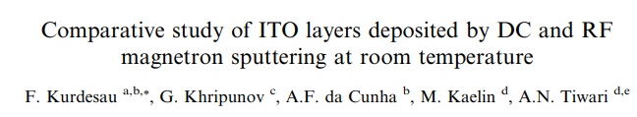
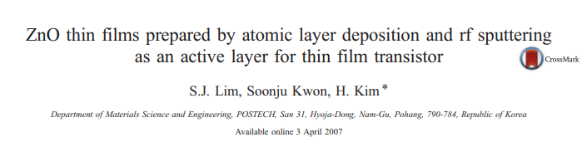
Thin film deposition techniques
2 papers:

Slide 34
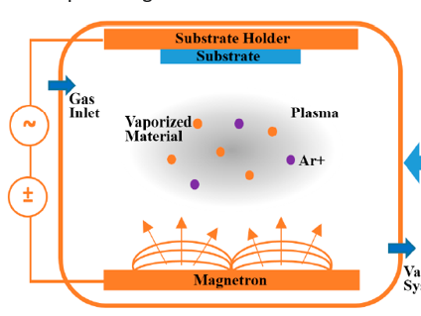
Thin film deposition techniques
Sputtering: ITO DC vs RF
Base pressure (O₂, Ar)
O₂, Ar
ITO target (10 wt% SnO₂)
Volume 352, Issues 9–20, 15 June 2006, Pages 1466-1470
Notes:
Redia frequency, direct current

Slide 35
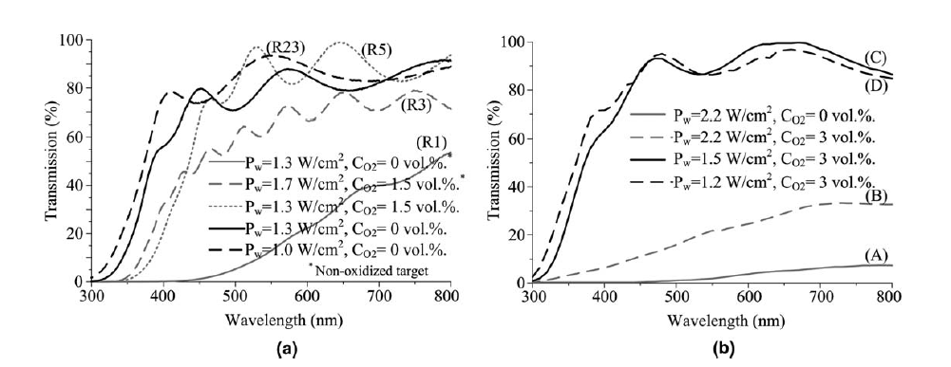
Thin film deposition techniques
Sputtering: ITO DC vs RF
Optical properties of ITO DC sputtered or RF sputtered
P_{w} = DC/RF power to sputter target
C_{O2} – concentration O₂ in vacuum chamber
DC sputtered ITO
60 nm/min; 300 nm
RF sputtered ITO
20 nm/min; 300 nm
Volume 352, Issues 9–20, 15 June 2006, Pages 1466-1470
Notes:
Transmission: different oxygen flow, also different power. RF took about xx times longer

Slide 36
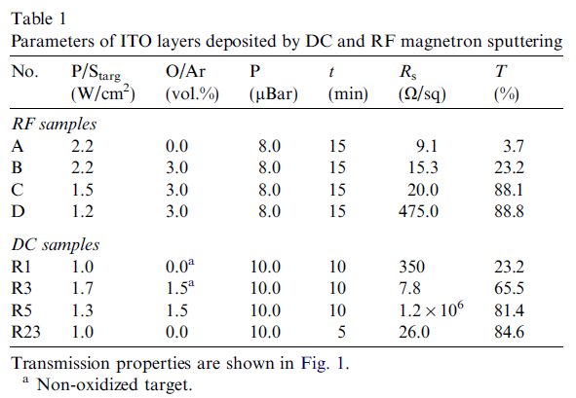
Thin film deposition techniques
Sputtering: ITO DC vs RF
Optical properties of ITO DC sputtered or RF sputtered
Opto-electrical properties (R_{s} and T) for different deposited layers
Low Rs high T is required for good transparent conductive layer
Volume 352, Issues 9–20, 15 June 2006, Pages 1466-1470
Notes:
Mass flow controllers
Turbo molecular pump

Slide 37
Thin film deposition techniques
R_{s} - sheet resistance
Free carriers (most often electrons e⁻)
Mobility of the free carriers (µ_{e})
Concentration of the free carriers (n)
Conductivity σ = e⁻nµ_{e}
A
Conductivity = σ (S/m)
Resistivity = ρ = 1/ σ (Ωm)
Resistance= R = ρ·t/A (Ω/m)
Sheet resistivity = R_{s} = ρ/t (Ω/sq)
t
https://www.vonardenne.biz/en/company/press-events/industrial-tcos-for-shj-solar-cells/

Slide 38
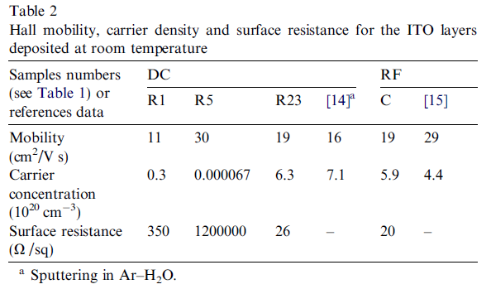
Thin film deposition techniques
Sputtering: ITO DC vs RF
Optical properties of ITO DC sputtered or RF sputtered
Low R_{s},high mobility, and low carrier concentration is required for good transparent conductive layer
Transmission 84.1% 88.1%
→ RF sputtering gives best properties of the TCO layer
Volume 352, Issues 9–20, 15 June 2006, Pages 1466-1470
Notes:
Mass flow controllers
Turbo molecular pump

Slide 39
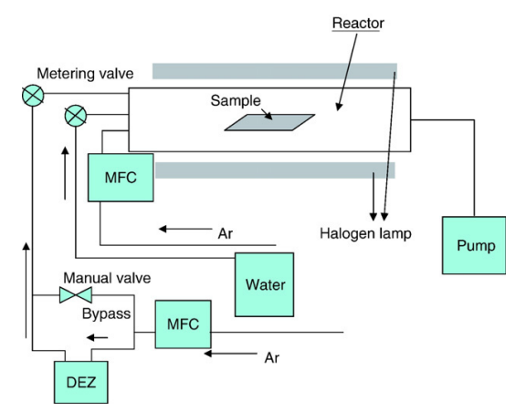
Thin film deposition techniques
ALD vs sputtering: ZnO
ZnO target
Precursors:
DEZ: diethyl-Zn water
Thin Solid Films 516 (2008) 1523–1528
Notes:
. In this study, we prepared ZnO films with ALD using diethyl Zn (DEZ) as a metal precursor and water as a reactant

Slide 40
Thin film deposition techniques
Atomic layer deposition: ALD
Atomic layer deposition
Zn
Zn
Zn
Zn
Zn
Zn
Zn
Zn
Zn
Zn
Zn
Zn

Slide 41
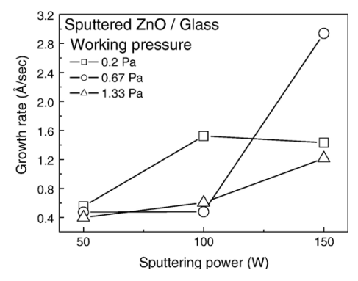
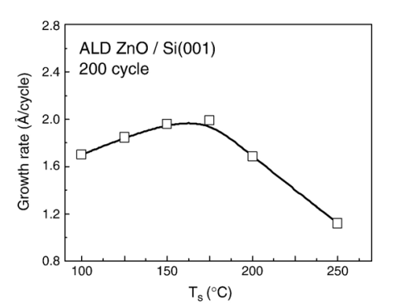
Thin film deposition techniques
ALD vs sputtering: ZnO
ALD is about 20 times slower
1 cycle ~ 17 seconds
Thin Solid Films 516 (2008) 1523–1528
Notes:
. In this study, we prepared ZnO films with ALD using diethyl Zn (DEZ) as a metal precursor and water as a reactant

Slide 42
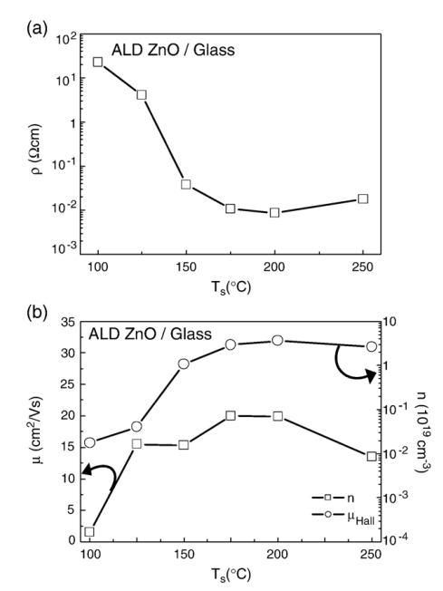
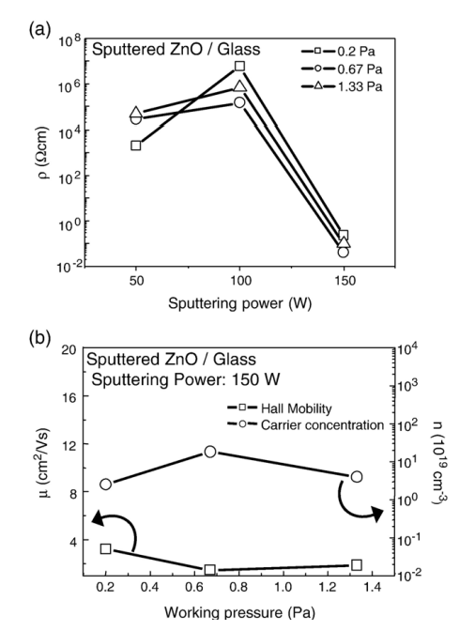
Thin film deposition techniques
ALD vs sputtering: ZnO
Electrical parameters highly dependent on the deposition method
Thin Solid Films 516 (2008) 1523–1528
Notes:
Komt door krstiallijne structuur en defects. ZnO via ALD is erg puur, geen defected, grain boundaries etc. met sputter heb je hoge energetische deeltjes die botsen. etc

Slide 43
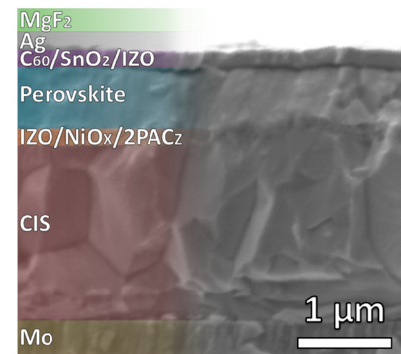
Thin film deposition techniques
Why ALD?
Conform layers
Extreme thin layers
Very thin SnO₂ ALD layer ‘closed’ the electron transport layers
C60 - evaporation
IZO - sputtering

Slide 44
Take away messages:
Wide range on thin film deposition techniques available
Examples are shown that are used in solar cell technology
Often multiple options are possible, choice depends on:
Quality of deposited layers
Deposition time
Deposition temperature
Conformality
Thickness
Deposition chamber
Throughput
Substrate size
→ examples for ZnO and ITO layers
Next lecture: functional structures in thin films

